Slide 1
C#4 & C#6 C#7 FEATURES
Continuous staff improvement
SERGIU GRAJDEAN & MAXIM PROCOPENCO & HOHAN IURIE & LUCASH OLEG

Slide 2
OBJECTIVES
C# EVOLUTION
C#4 FEATURES
C#6 FEATURES
C#7 FEATURES
CASTING AND REFERENCE CONVERSIONS
Implicit Conversions
Explicit Conversions
Type Conversion Exceptions at Run Time
Safe Type cast : AS operator
Safe Type cast : IS operator

Slide 3
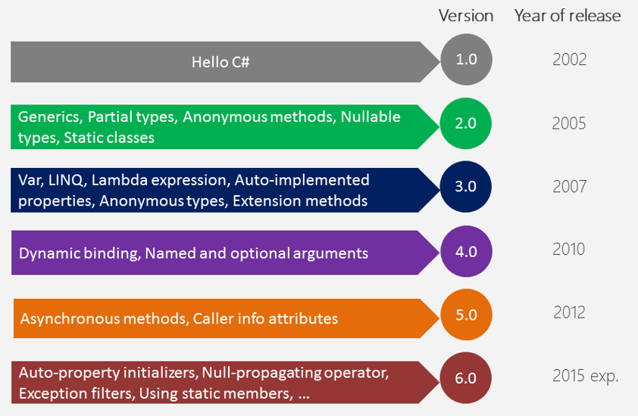
C# EVOLUTION

Slide 4
C# 4 – COM SUPPORT
1. Big feature – dynamic typing.
2. Optional params and named arguments.
1 & 2 is for better COM support, features existing in VB and migrated to C#
Generic variance for interfaces and delegates -> for self learning
Other tiny changes for robust locking & field-like events.
Generally not that big impact release, features are not used as they were meant to.

Slide 5
OPTIONAL PARAMETERS
Motivation is to reduce the number of overloads of a function
static void Foo(string s, int i = 10, bool canMake = true)
{
Console.WriteLine(s);
Console.WriteLine(i);
Console.WriteLine(canMake);
}
static void Main(string[] args)
{
Foo("hi");
Foo("hi", 2);
Foo("hi", 5,false);
}

Slide 6
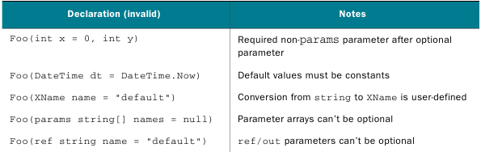
OPTIONAL PARAMETERS - RESTRICTIONS
Should follow required parameters (only after). The exception is parameter array, which has to come at the end.
Do not combine with ref and out keywords.
Constants: literals, null, const, enum members, default(T) operator.
Should be an implicit, not user-defined conversion.
Default value for Reference type except of string can be just null

Slide 7
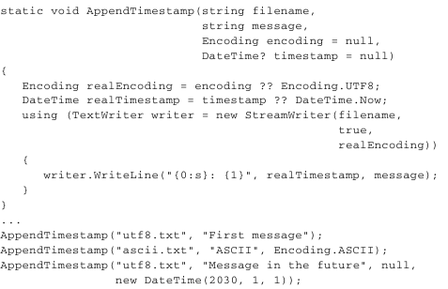
GETTING OTHER CONST RESTRICTION

Slide 8
NAMED ARGUMENTS
Named arguments free you from the need to remember or to look up the order of parameters in the parameter lists of called methods – culture of writing “clean code”.
The parameter for each argument can be specified by parameter name.
Positional arguments cannot follow named arguments.

Slide 9
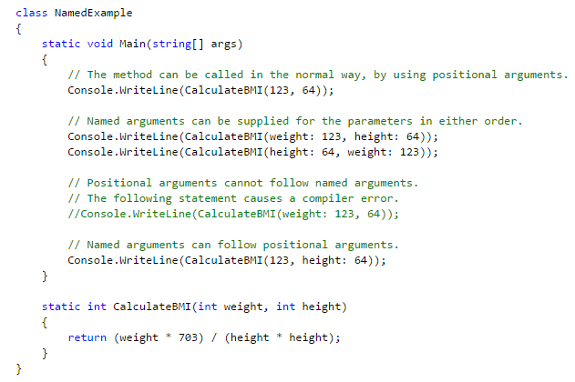
NAMED ARGUMENTS

Slide 10
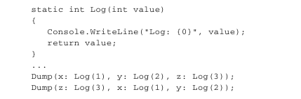
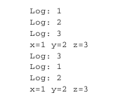
NAMED ARGUMENTS – EVALUATION ORDER
One should avoid changing execution order but it can potentially make code clearer. It is even worse when execution parameters depend one on another.

Slide 11
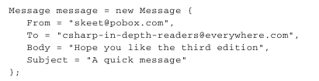

OPTIONAL & NAMED ARGUMENTS – USING TWO OF THEM TOGETHER
Both techniques are often combined together.
One extremely popular use case is to make objects immutable (unchangeable).

Slide 12
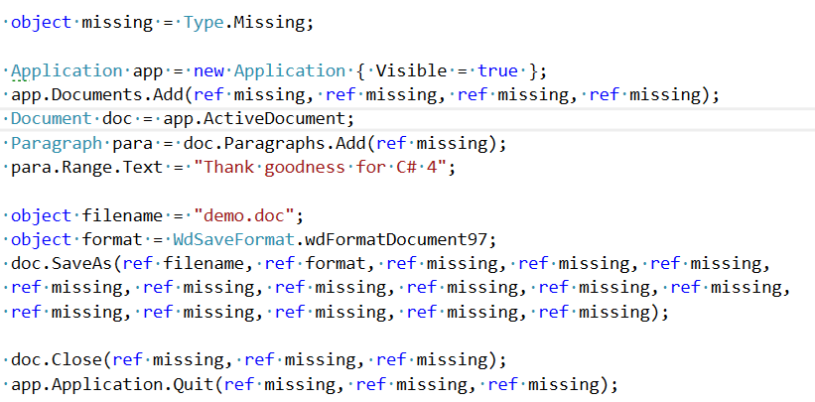
WORD EXAMPLE - BEFORE

Slide 13
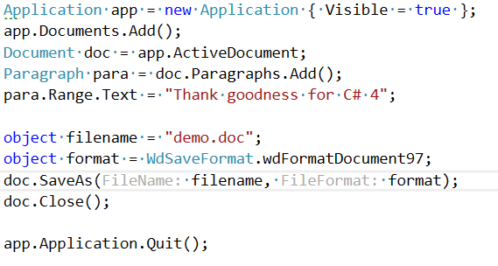
WORD EXAMPLE - AFTER

Slide 14
DYNAMIC IN C#
C# has always been statically typed language. Since C# 4 it is partially dynamic.
In simple words, a new static type called dynamic, which you can try to do almost anything with at compile time and let the framework sort it out at execution time.
When introduced, it was aimed at interoperability and use with dynamic languages such as IronPython.
Do use only when necessary, slower and more complicated in most cases.

Slide 15
DYNAMIC IN C# - HOW IT WORKS
The process of working out which member to use is called binding, and in a statically typed language it occurs at compile time.
In a dynamically typed language, all of this binding occurs at execution time.
A compiler or parser can check that the code is syntactically correct, but it can’t check that the methods you call and the properties you access are actually present.

Slide 16
DYNAMIC IN C# - WHEN TO USE
To call a method one, one needs to know the type of the object you’re calling it on and the types of the arguments.
Sometimes you don’t know those types at compile time, even though you do know enough to be sure that the member will be present and correct when the code runs.

Slide 17
DYNAMIC IN C#
C# 4 introduces a new type called dynamic, a new CLR type.
Instead of emitting IL to execute the code directly, the compiler generates code that calls into the DLR with all the required information. The rest of the work is performed at execution time.
An implicit conversion exists from almost any CLR type to dynamic.
An implicit conversion exists from any expression of type dynamic to almost any CLR type.
Expressions that use a value of type dynamic are usually evaluated dynamically.
The static type of a dynamically evaluated expression is usually dynamic.

Slide 18
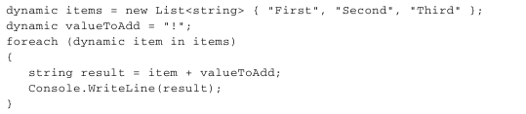
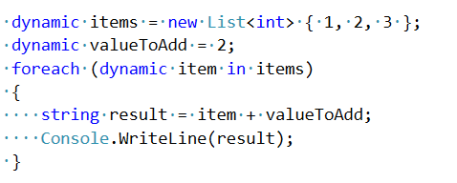
DYNAMIC IN C# - EXAMPLE
Expected result First!, Second!, Third!

Slide 19
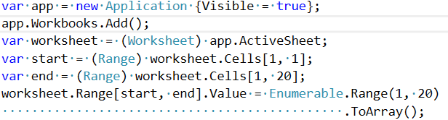
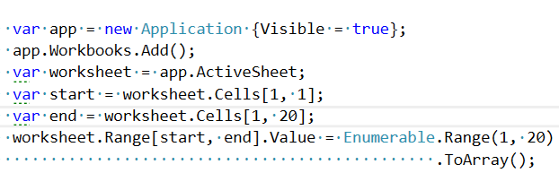
DYNAMIC IN C# - COM USAGE

Slide 20
DYNAMIC IN C# - REAL WORLD USAGE
Dapper (https://github.com/StackExchange/Dapper),
Json.NET (https://github.com/JamesNK/Newtonsoft.Json).
These examples are all at data boundaries—whether that’s when talking to a database, or serializing and deserializing JSON

Slide 21
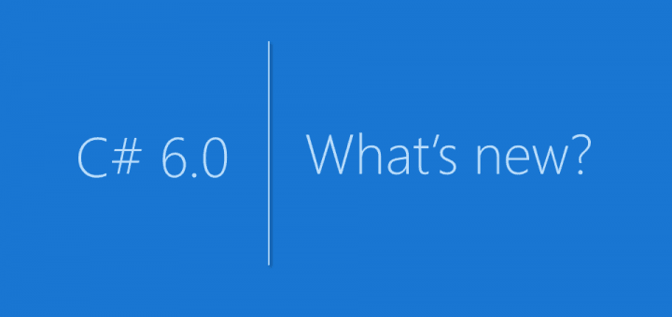

Slide 22
AUTO PROPERTIES INITIALIZERS – OLD WAY
class Person
{
private string _name;
public string Name
{
get { return _name; }
}
public DateTime DateOfBirth { get;set; }
public Person(string name, DateTime dateOfBirth)
{
_name = name;
DateOfBirth = dateOfBirth;
}
}

Slide 23
AUTO PROPERTIES INITIALIZERS – NEW WAY
class Person
{
public Person(string name, DateTime dateOfBirth)
{
Name = name;
DateOfBirth = dateOfBirth;
}
public string Name { get; }
public DateTime DateOfBirth { get; } = DateTime.Now;
public Person(string name)
{
Name = name;
}
}

Slide 24
EXPRESSION-BODIED MEMBERS – OLD WAY
class Person
{
public Person(string firstName, string lastName, DateTime dateOfBirth)
{
FirstName = firstName;
LastName = lastName;
DateOfBirth = dateOfBirth;
}
public string FirstName { get; }
public string LastName { get; }
public string FullName {
get { return FirstName + LastName; }
}
public DateTime DateOfBirth { get; } = DateTime.Now;
}

Slide 25
EXPRESSION-BODIED MEMBERS – NEW WAY
class Person
{
public Person(string firstName, string lastName, DateTime dateOfBirth)
{
FirstName = firstName;
LastName = lastName;
DateOfBirth = dateOfBirth;
}
public string FirstName { get; }
public string LastName { get; }
public string FullName () => FirstName + LastName;
public int Age() => (int)(DateTime.Now - DateOfBirth).TotalDays / 365;
public DateTime DateOfBirth { get; } = DateTime.Now;
}

Slide 26
NAMEOF EXPRESSION - BEFORE
public static void DoSomething(string name)
{
if (name == null)
{
throw new Exception("Name is null");
}
}

Slide 27
NAMEOF EXPRESSION – NEW WAY
public static void DoSomething(string newName)
{
if (newName == null)
{
throw new Exception(nameof(newName) + " is null");
}
}

Slide 28
STATIC USING SYNTAX – OLD WAY
Before
class UsingStatic
{
internal static double Maths(int x)
{
return Math.Sqrt(Math.Sin(x) + Math.Cos(x));
}
}

Slide 29
STATIC USING SYNTAX – NEW WAY
After
using static System.Math;
namespace LINQDemo
{
class UsingStatic
{
internal static double Maths(int x)
{
return Sqrt(Sin(x) + Cos(x));
}
}
}

Slide 30
DICTIONARY INITIALIZERS
Before
var stars = new Dictionary<string, string>()
{
{ "Michael Jordon", "Basketball" },
{ "Peyton Manning", "Football" },
{ "Babe Ruth", "Baseball" }
};

Slide 31
DICTIONARY INITIALIZERS
After
var stars = new Dictionary<string, string>()
{
["Michael Jordan"] = "Basketball",
["Peyton Manning"] = "Football",
["Babe Ruth"] = "Baseball"
};

Slide 32
STRING INTERPOLATION
Before
static void Main(string[] args)
{
string firstName = "Michael";
string lastName = "Crump";
Console.WriteLine("Name : " + firstName + " " + lastName);
Console.WriteLine("Name : {0} {1}", firstName, lastName);
Console.ReadLine();
}

Slide 33
STRING INTERPOLATION
After
static void Main(string[] args)
{
string firstName = "Michael";
string lastName = "Crump";
WriteLine($"{firstName} {lastName} is my name!");
ReadLine();
}

Slide 34
EXCEPTION FILTERS
Before
static void Main(string[] args)
{
var httpStatusCode = 404;
Write("HTTP Error: ");
try
{
throw new Exception(httpStatusCode.ToString());
}
catch (Exception ex)
{
if (ex.Message.Equals("500"))
Write("Bad Request");
else if (ex.Message.Equals("401"))
Write("Unauthorized");
else if (ex.Message.Equals("402"))
Write("Payment Required");
else if (ex.Message.Equals("403"))
Write("Forbidden");
else if (ex.Message.Equals("404"))
Write("Not Found");
}
ReadLine();
}

Slide 35
EXCEPTION FILTERS
After
try
{
throw new Exception(httpStatusCode.ToString());
}
catch (Exception ex) when (ex.Message.Equals("400"))
{ Write("Bad Request");
}
catch (Exception ex) when (ex.Message.Equals("401"))
{
Write("Unauthorized");
}
catch (Exception ex) when (ex.Message.Equals("402"))
{
Write("Payment Required");
}
catch (Exception ex) when (ex.Message.Equals("403"))
{
Write("Forbidden");
}
catch (Exception ex) when (ex.Message.Equals("404"))
{
Write("Not Found");
}

Slide 36
NULL CONDITIONAL OPERATOR
Before
static void Test(Person person)
{
WriteLine(person != null ? person.Name : "Field is null.");
}

Slide 37
NULL CONDITIONAL OPERATOR
After
static void Test(Person person)
{
WriteLine(person?.Name ?? "Field is null.");
}
New example
static void Test(Person person)
{
var first = person?.Name;
}

Slide 38

C# 7.0

Slide 39
OUT VARIABLES
Before
int numericResult;
if (int.TryParse(input, out numericResult))
WriteLine(numericResult);
else
WriteLine("Could not parse input");
After
if (int.TryParse(input, out int result))
WriteLine(result);
else
WriteLine("Could not parse input");

Slide 40
TUPLES
Declarations
1) var letters = ("a", "b");
2) (string Alpha, string Beta) namedLetters = ("a", "b");
3) var alphabetStart = (Alpha: "a", Beta: "b");
//warning - telling you that the names on the right side of the assignment re ignored because they conflict with the names on the left side
4) (string First, string Second) firstLetters = (Alpha: "a", Beta: "b");

Slide 41
TUPLES
Example
private static (int Max, int Min) Range(IEnumerable<int> numbers)
{
int min = int.MaxValue;
int max = int.MinValue;
foreach (var n in numbers)
{
min = (n < min) ? n : min;
max = (n > max) ? n : max;
}
return (max, min);
}

Slide 42
DISCARDS
public static void Main() { var (_, _, _, pop1, _, pop2) = QueryCityDataForYears("New York City", 1960, 2010); Console.WriteLine($"Population change, 1960 to 2010: {pop2 - pop1:N0}"); } private static (string, double, int, int, int, int)
QueryCityDataForYears(string name, int year1, int year2) { int population1 = 0, population2 = 0; double area = 0;
....
return (name, area, year1, population1, year2, population2); }

Slide 43
PATTERN MATCHING
Example
public static int DiceSum2(IEnumerable<object> values)
{
var sum = 0;
foreach (var item in values)
{
if (item is int val)
sum += val;
else if (item is IEnumerable<object> subList)
sum += DiceSum2(subList);
}
return sum;
}

Slide 44
REF LOCALS AND RETURNS
static ref int Find(int number, int[] numbers)
{
for (int i = 0; i < numbers.Length; i++)
{
if (numbers[i] == number)
{
return ref numbers[i]; // we return reference, not value
}
}
throw new IndexOutOfRangeException("Number is not found");}
static void Main(string[] args)
{
int[] numbers = { 1, 2, 3, 4, 5, 6, 7 };
ref int numberRef = ref Find(4, numbers); //finding 4 in array
numberRef = 9; //change 4 to 9
Console.WriteLine(numbers[3]); // 9
Console.Read();}

Slide 45
LOCAL FUNCTIONS
static int GetResult(int[] numbers) {
int limit = 0;
// local function
bool IsMoreThan(int number)
{
return number > limit;
}
int result = 0;
for (int i = 0; i < numbers.Length; i++)
{
if (IsMoreThan(numbers[i]))
{
result += numbers[i];
}
}
return result;
}

Slide 46
CASTING AND REFERENCE CONVERSIONS
Because C# is statically-typed at compile time, after a variable is declared, it cannot be declared again or used to store values of another type unless that type is convertible to the variable's type.
Operation which converts one type to another are called type conversions
Implicit conversions: No special syntax is required because the conversion is type safe and no data will be lost.
Explicit conversions (casts): Explicit conversions require a cast operator. Casting is required when information might be lost in the conversion, or when the conversion might not succeed for other reasons.
User-defined conversions: User-defined conversions are performed by special methods that you can define to enable explicit and implicit conversions between custom types that do not have a base class–derived class relationship.
Conversions with helper classes: To convert between non-compatible types.

Slide 47
IMPLICIT CONVERSIONS
For built-in numeric types, an implicit conversion can be made when the value to be stored can fit into the variable without being truncated or rounded off
For reference types, an implicit conversion always exists from a class to any one of its direct or indirect base classes or interfaces
int num = 2147483647;
long bigNum = num;
class A
{
}
class B : A
{
}
B b= new B();
A a = b;

Slide 48
EXPLICIT CONVERSIONS
If a conversion cannot be made without a risk of losing information, the compiler requires that you perform an explicit conversion, which is called a cast
long bigNum = 2147483647;
int num = (int)bigNum;
class A
{
}
class B : A
{
}
A a = new B();
B b = (B)a;

Slide 49
TYPE CONVERSION EXCEPTIONS AT RUN TIME
In some reference type conversions, the compiler cannot determine whether a cast will be valid. It is possible for a cast operation that compiles correctly to fail at run time.
If type cast fails at runtime an InvalidCastException is thrown.
class A
{
}
class B : A
{
}
A a = new A();
B b = (B)a;

Slide 50
SAFE TYPE CAST : AS OPERATOR
You can use the as operator to perform certain types of conversions between compatible reference types or nullable types.
The as operator is like a cast operation. However, if the conversion isn't possible, as returns null instead of raising an exception.
The as operator performs only reference conversions, nullable conversions, and boxing conversions. The as operator can't perform other conversions, such as user-defined conversions, which should instead be performed by using cast expressions.
Example
class A{}
class B : A{}
A a = new A();
B b = a as B;

Slide 51
SAFE TYPE CAST : IS OPERATOR
Is Operator – checks if an object is compatible with a given type.
An is expression evaluates to true if the provided expression is non-null, and the provided object can be cast to the provided type without causing an exception to be thrown.
The is keyword causes a compile-time warning if the expression is known to always be true or to always be false, but typically evaluates type compatibility at run time.
The is operator cannot be overloaded.
The is operator only considers reference conversions, boxing conversions, and unboxing conversions. Other conversions, such as user-defined conversions, are not considered.
Anonymous methods are not allowed on the left side of the is operator. This exception includes lambda expressions.

Slide 52
SAFE TYPE CAST : IS OPERATOR
Example
class A{}
class B: A{}
class C: B{}
class X: A{}
A a= new C();
Console.WriteLine(a is A); // true
Console.WriteLine(a is B); // true
Console.WriteLine(a is C); // true
Console.WriteLine(a is X); // false

Slide 53
ASSIGNMENT
THINK OF A METHOD WITH OPTIONAL PARAMETERS IN YOUR DOMAIN
CALL METHODS WITH OPTIONAL PARAMETERS AND USING NAMED ARGUMENTS
EXPERIMENT WITH DYNAMIC
CONVERT TO AUTOPROPERTY
CONSIDER EXPRESSION BODIED METHODS
CONSIDER STRING INTERPOLATION
THINK OF EXCEPTION FILTERING APPLICATION
PRECONDITIONS WITH NAMEOF
SEE IF YOU CAN APPLY NULL CONDITIONAL OPERATOR
TEST C# 7.0 FEATURES
SELF STUDY CONVERSIONS

Slide 54
REFERENCES
Albahari J, Albahari B. C# 6.0 in a Nutshell.
How to: Safely Cast by Using as and is Operators
Casting and Type Conversions
C# 7.0 features

Slide 55
REVISIONS
Number | Author | Date | Description
1.0.0 | Serghei Grajdean | 07.12.2015 | Initial version
1.1.0 | Maxim Procopenco | 09.03.2016 | C# 6 features
1.2.0 | Lucash Oleg | 19.03.2017 | C# 7 features

